Slide 1
Proposal Storyboard
Understanding/estimating C transport across flatwoods landscapes.
Can hydrologic management optimize C sequestration?
“Given that wetlands are intermediates between terrestrial and aquatic ecosystems and that their high CO₂ ﬂuxes are sustained by direct atmospheric CO₂ ﬁxation by emergent plants, we have chosen to exclude the direct ﬂuxes from our aggregate estimate.” (Drake et al 2018)

Slide 2
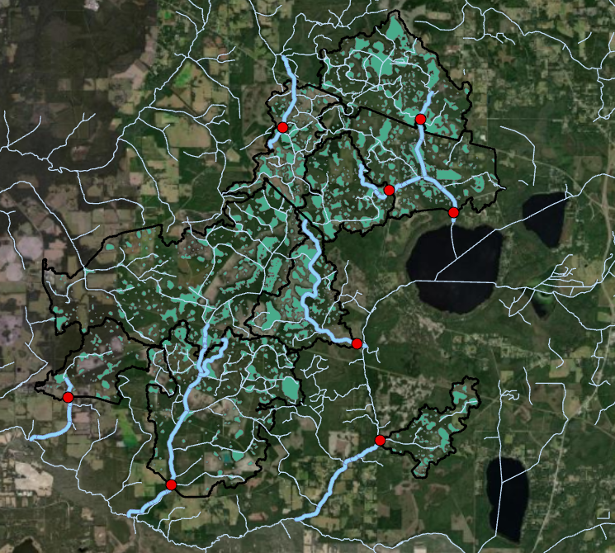
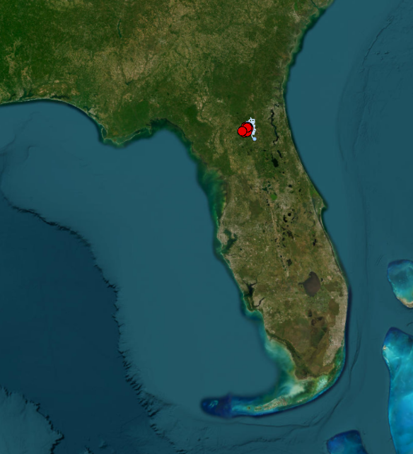


Sites
Streams
Wetlands
Basin Boundary
3725 m

Slide 3
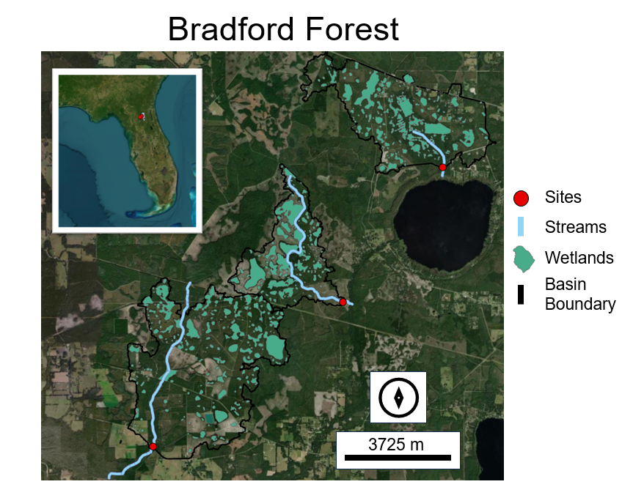
6
9
5

Slide 4
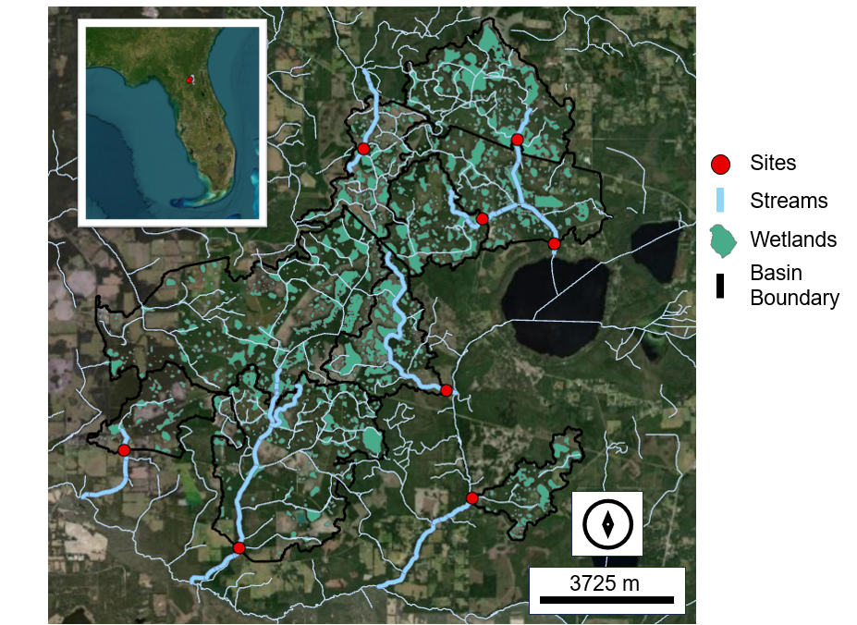
Bradford Forest

Slide 5
TO ask
DIC… do we still want to take these samples
Change CO2 to two hours

Slide 6
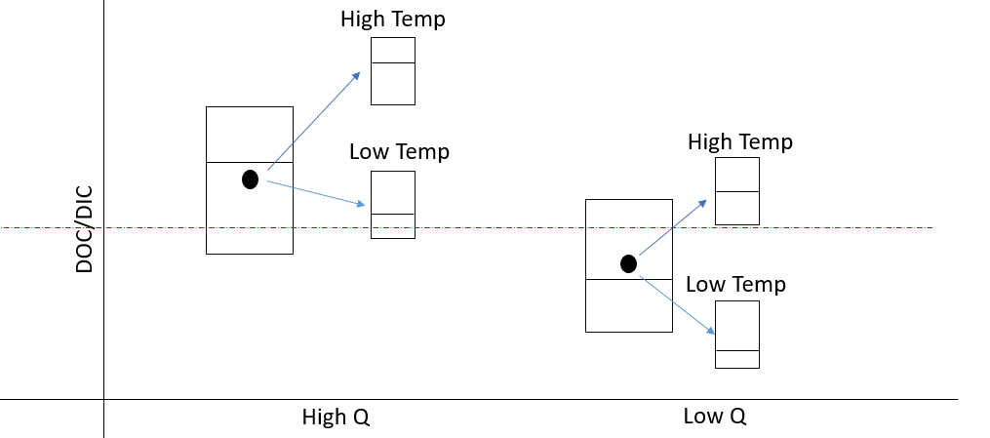
H1: Flatwood streams situationally flip between reactive and chimney pathways during high and low discharge (respectively).
*I hypothesize most C is DIC, namely in the from of dissolved CO₂
Greater DOC
Greater DIC
High Q:
Low Q:
Rainfall delivers great DOC
DOC
DIC
Less external C inputs, low redox resulting in CO2
DOC
DIC
POC
POC

Slide 7
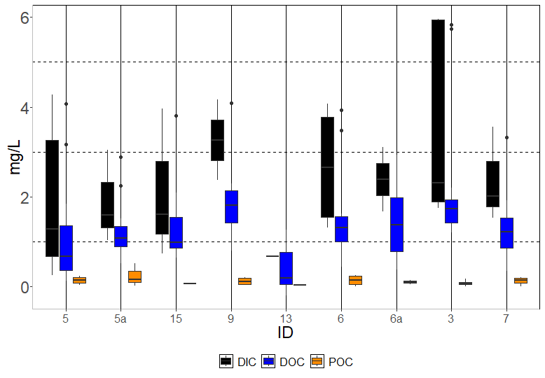
North
South

Slide 8
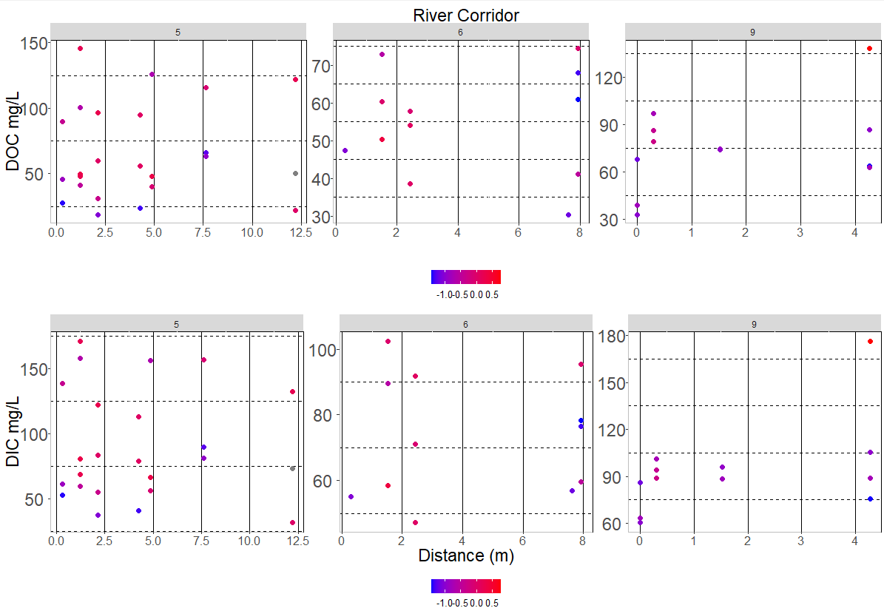

Slide 9
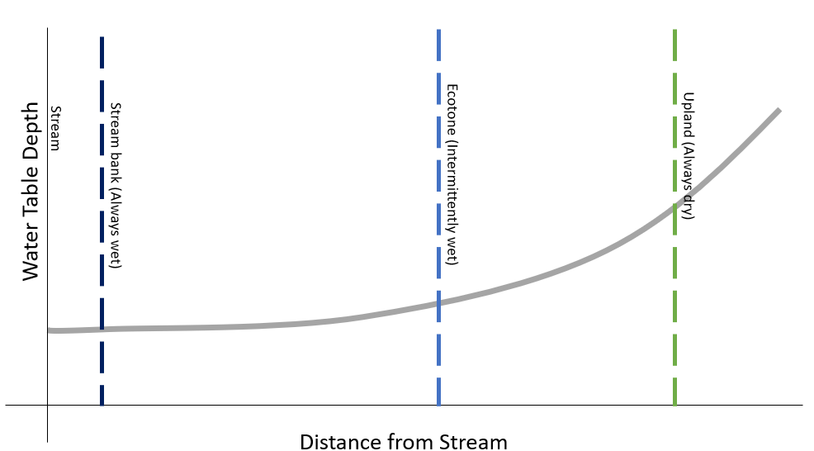
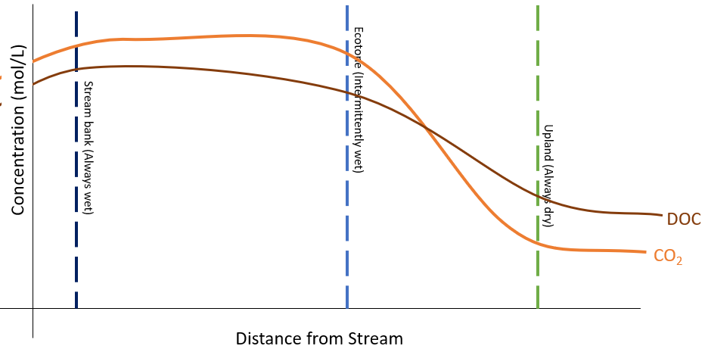
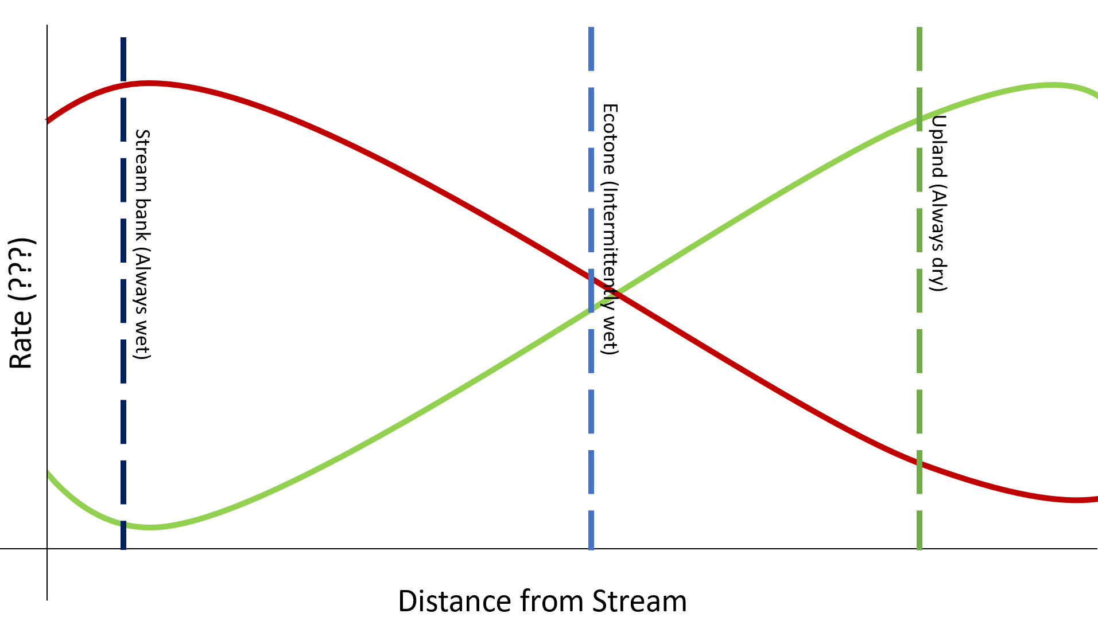
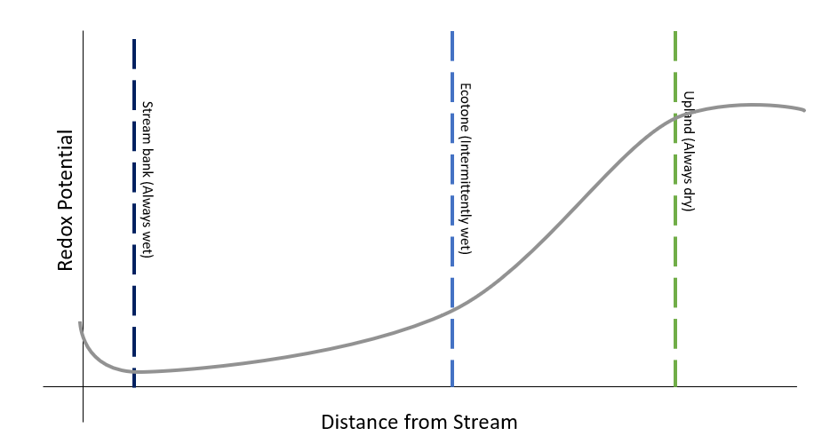
H2: The river corridor- the ecotone between the upland terrestrial landscape and the stream channel- delivers majority of the DOC to streams and is a significant carbon stock in flatwood landscape.

Slide 10
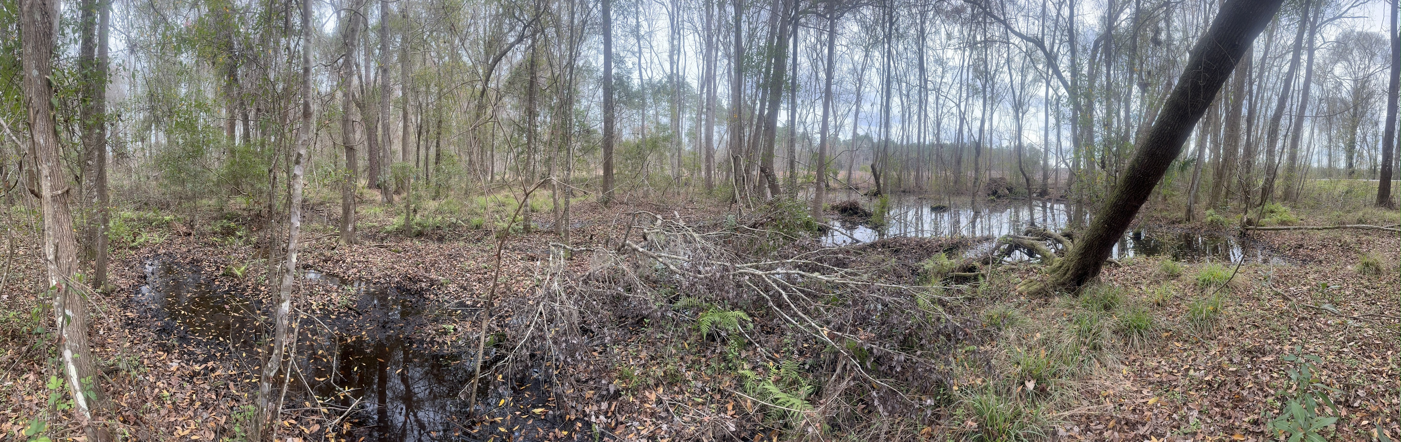
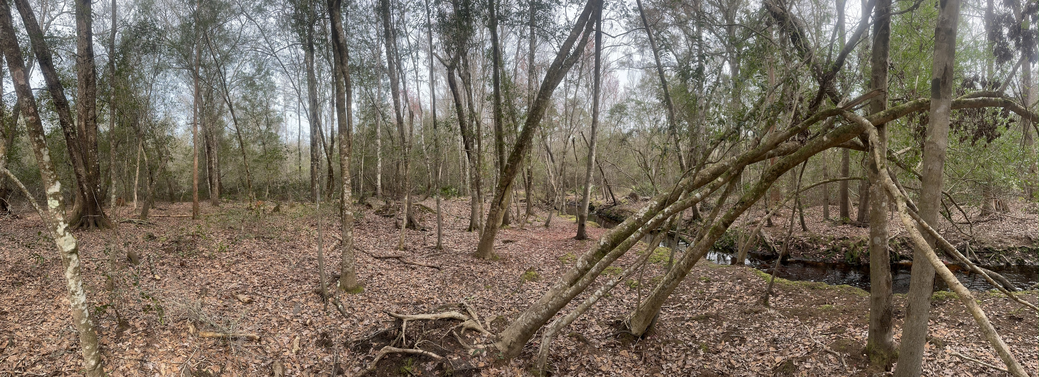
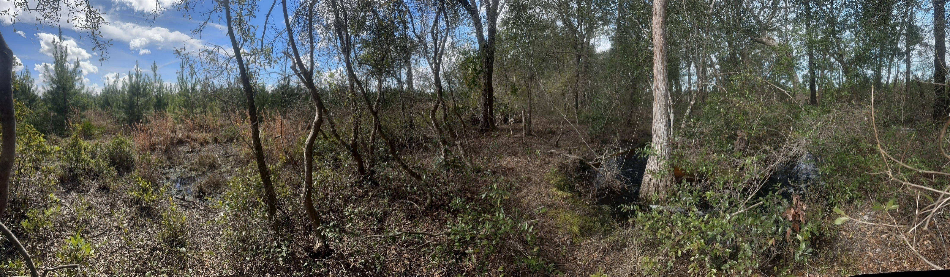
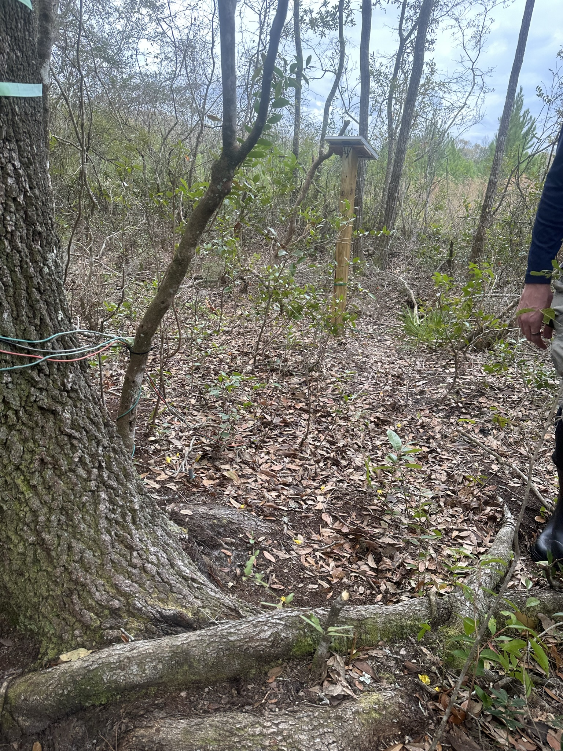
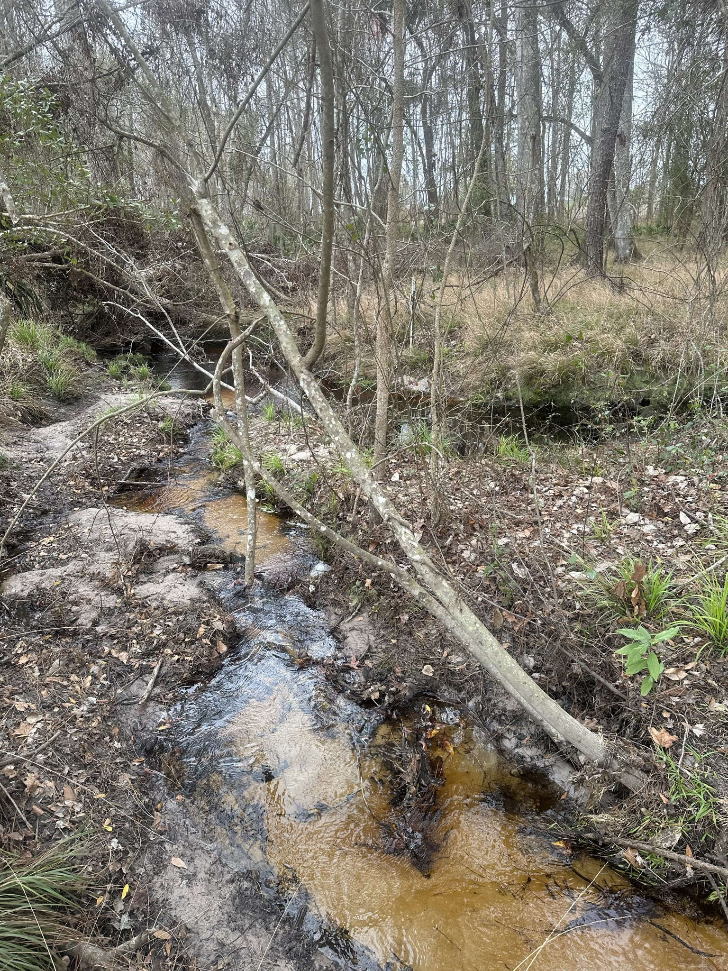
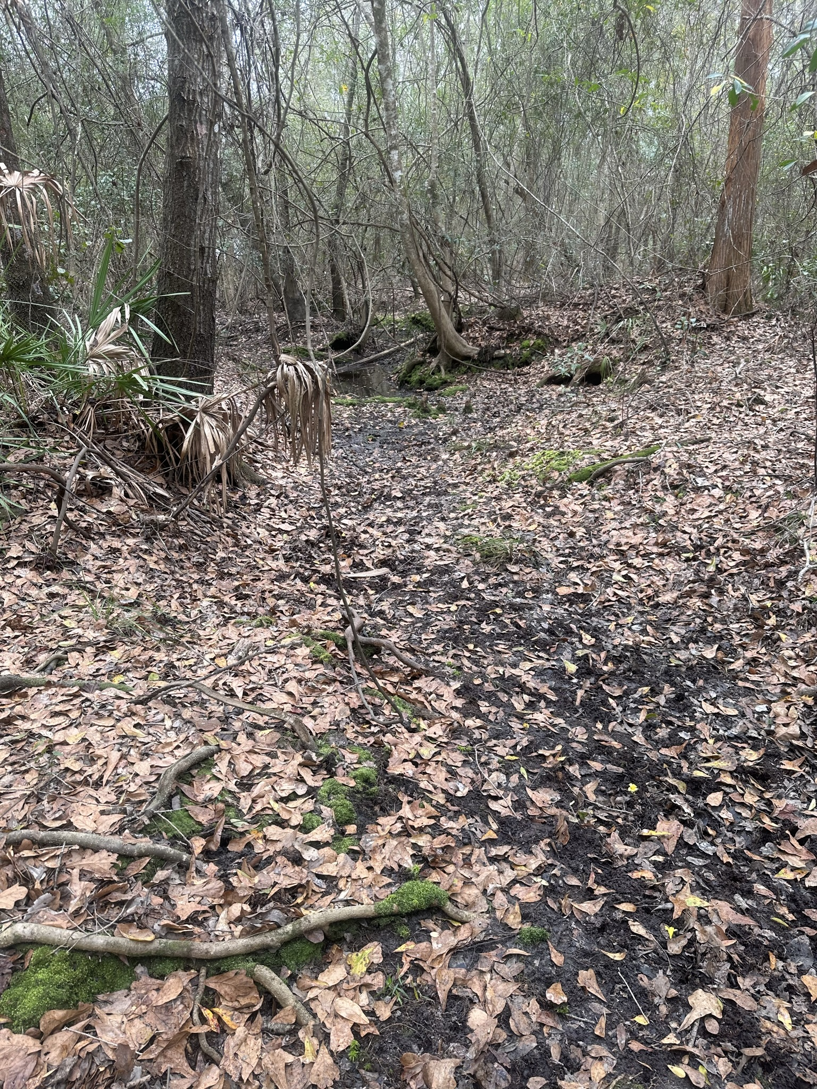
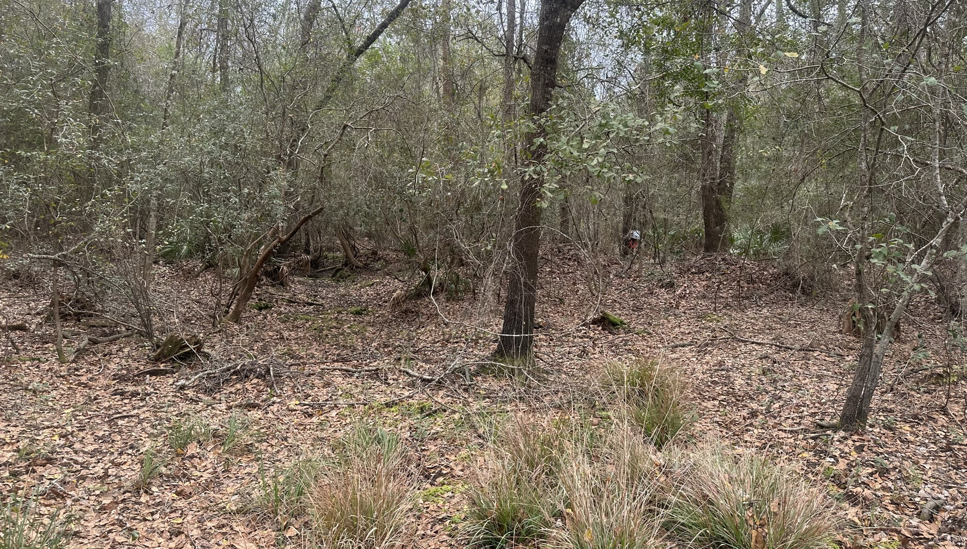
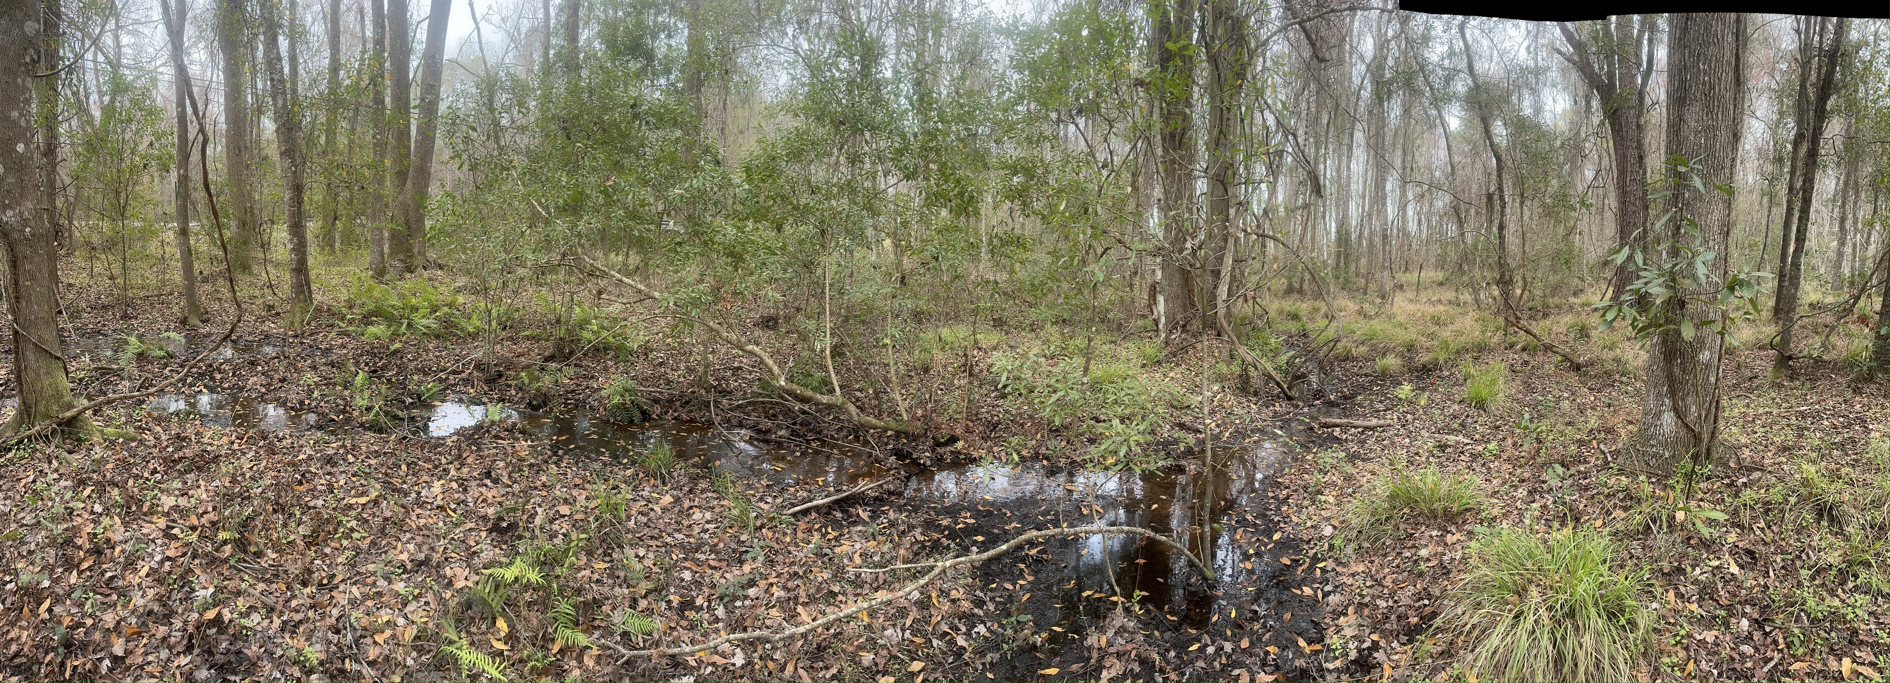
Wet
Dry
Stream 5:
Perennial streams and many ephemeral streams
A few depressions and one large wetland
Ground is damp
Longer saturated zone that transitions into tree
Would require the most resources
Stream 6:
No perennial streams
Fewer ephemeral streams
One noticeable major
Ground is dry
Short saturated zone with sphagnum moss, long grass/shrub zone
Easy to access
Steam 9:
No perennial stream
Experiences sheet flow post-rain events but no clear stream incisions
Ground is dry
Distinct ecotones
Short saturated zone/riverbank with sphagnum moss, zone with grasses/ shrubs that transitions to pine stands
Cons: challenging to access. Near road

Slide 11
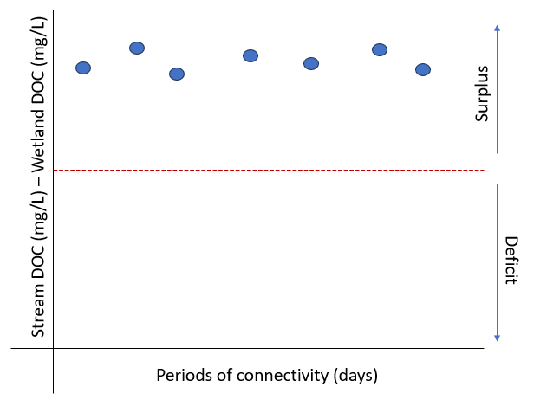
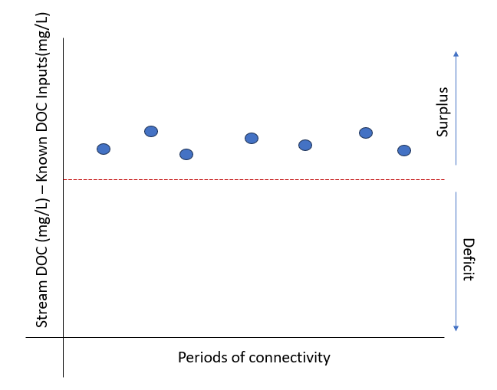
H3: Intermittent and ephemeral flow paths deliver more C to flatwood streams than their intermittently connected wetland.
*Goals: Modify the Wetland C Pump idea. Expand on the ecological importance of intermittent streams (WOTUS)
0
*By this chapter we will roughly know what is provided by the uplands and river corridor.
(Abril & Borges, 2019; Harvey & Gooseff, 2015; Kirk & Cohen, 2023)

Slide 12
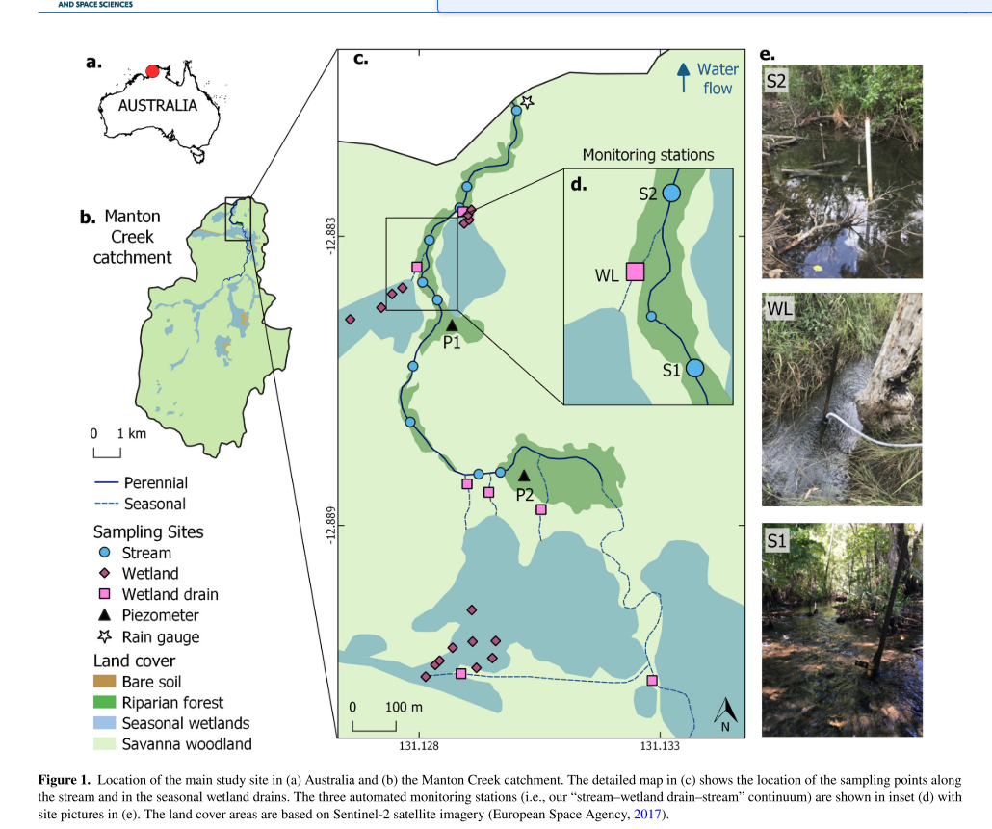
Solano et al. 2024
Found ~16% of carbon was delivered to wetlands. The rest from groundwater inputs
Only observed during monsoon season.
Less detailed riparian corridor sampling
I think we can model our methods after there's.
I more concerned with the intermittent streams than the wetland connectivity. I want to know where the majority of stream C is sourced, especially the carbon initially delivered to streams with the storm pulse
As an add on, is the C sourced from wetlands vs river corridor vs intermittent stream more preferred by microbes than others?
Dark/light dark incubations? I don’t think the FDOM can answer this Q.

Slide 13
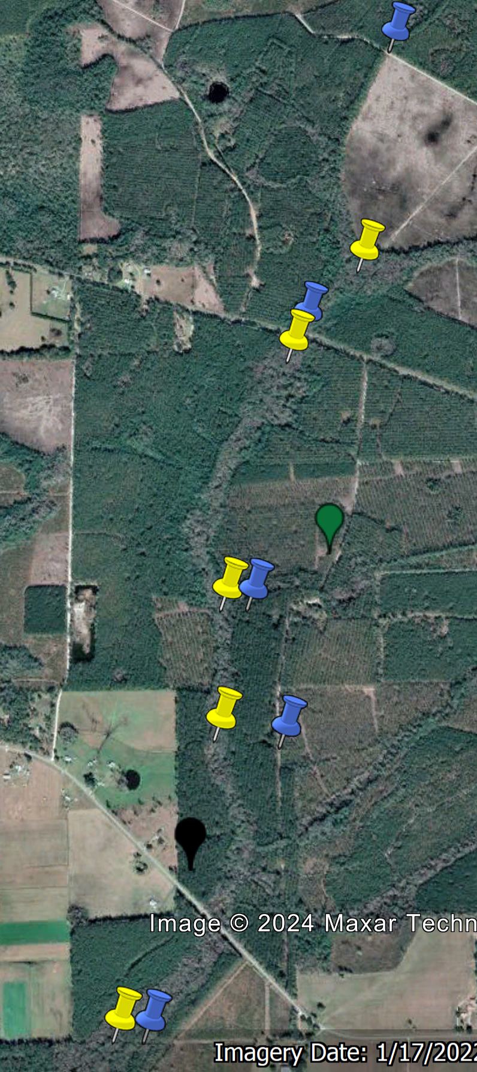
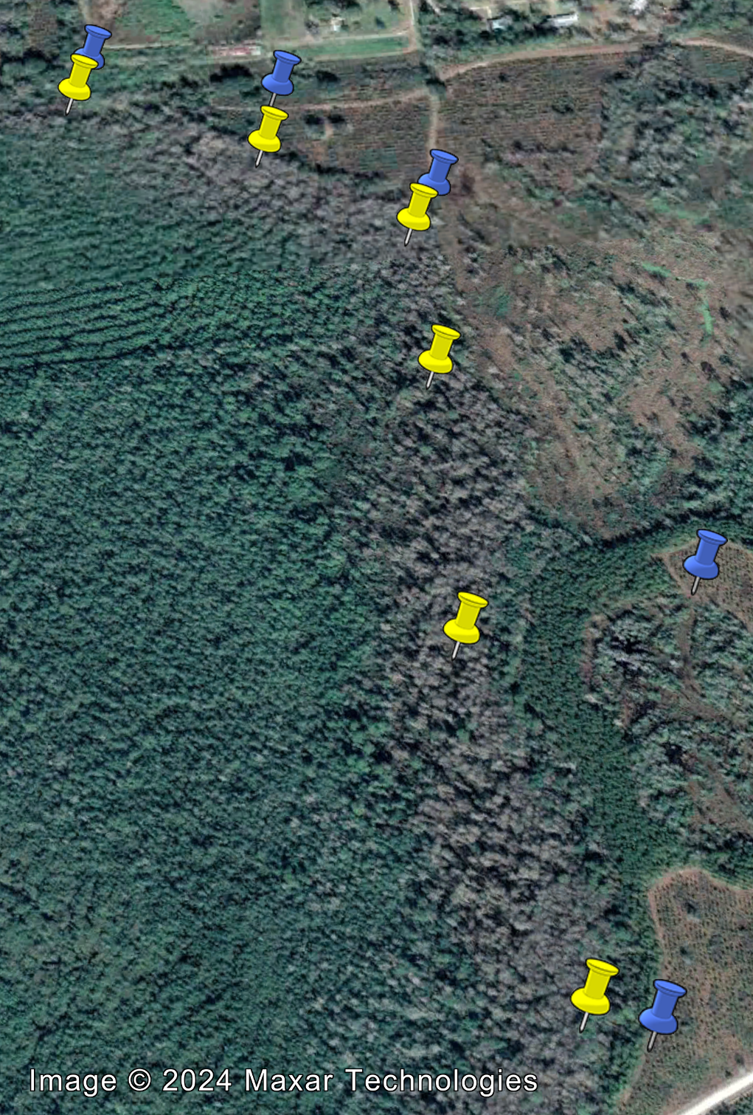
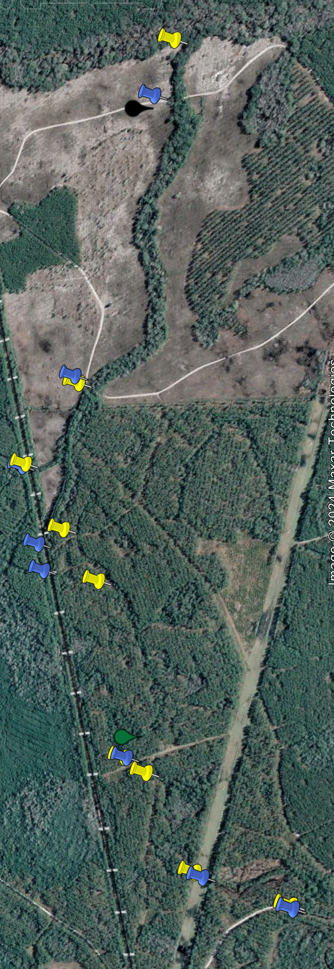

Slide 14
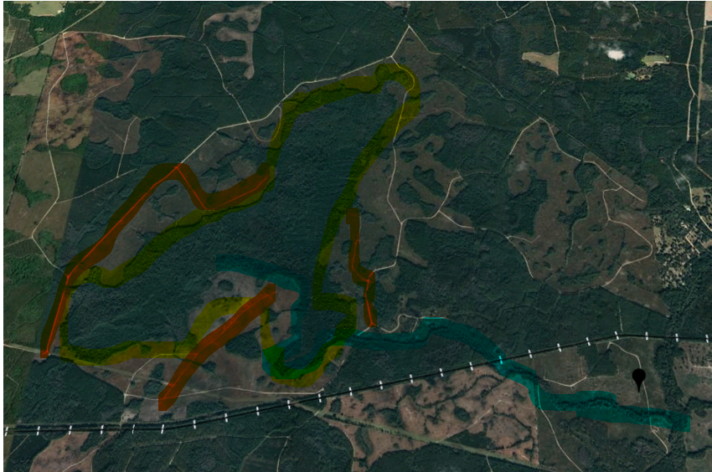
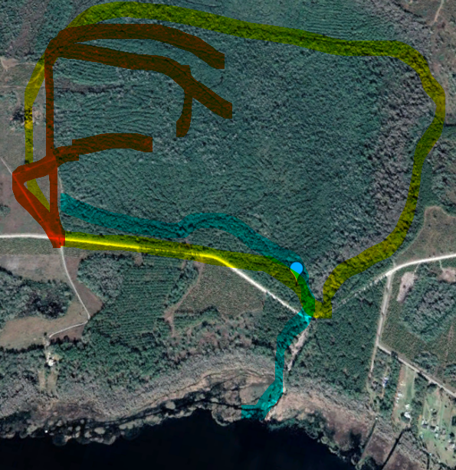
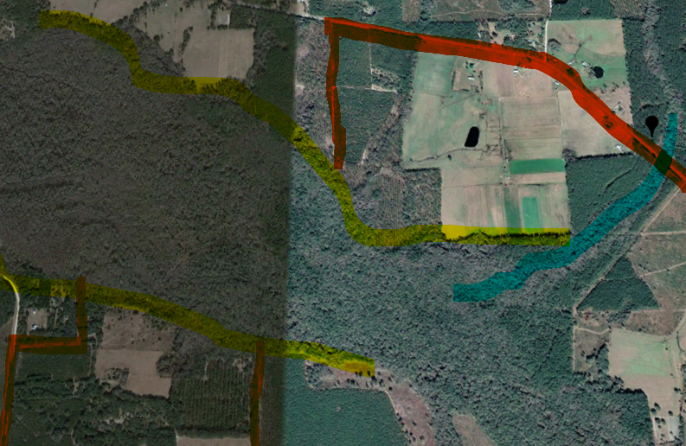
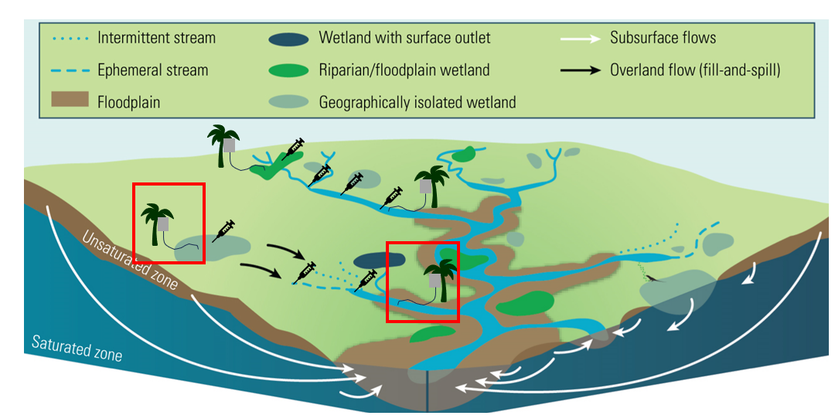
9
6
5

Slide 15
Project Progress
Deployed Vaisalas at 5 and 15 (see next slide)
The lithium batteries are dying after three weeks. So, I will visit Bradford after three weeks
Met with Amanda about the Shimadzu
Met with Audrey to discuss processing FDOM… I am going to teach a crash course

Slide 16
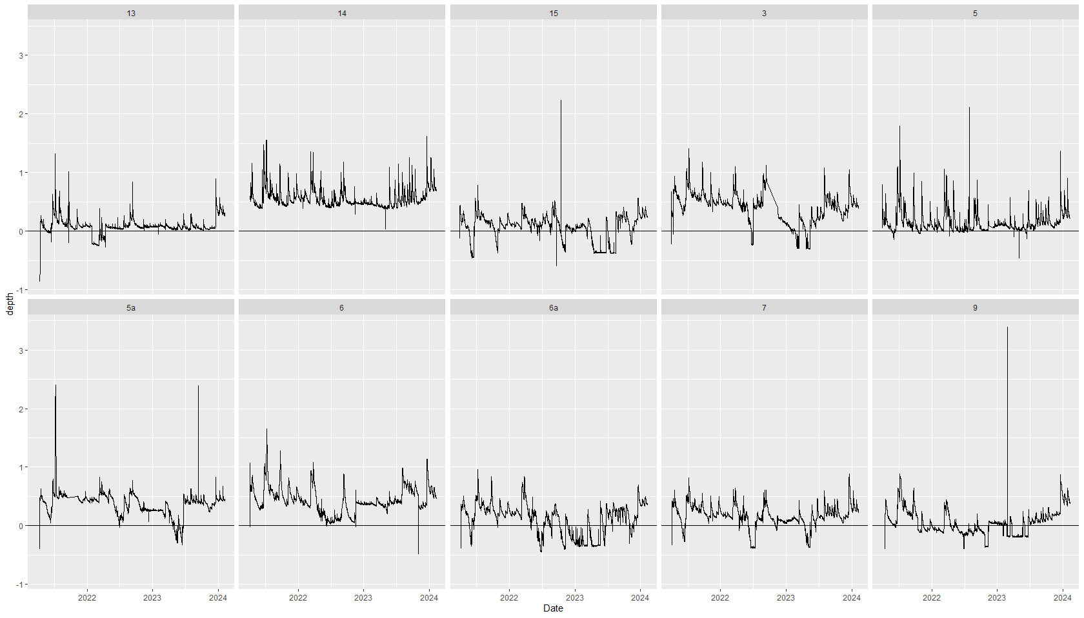

Slide 17
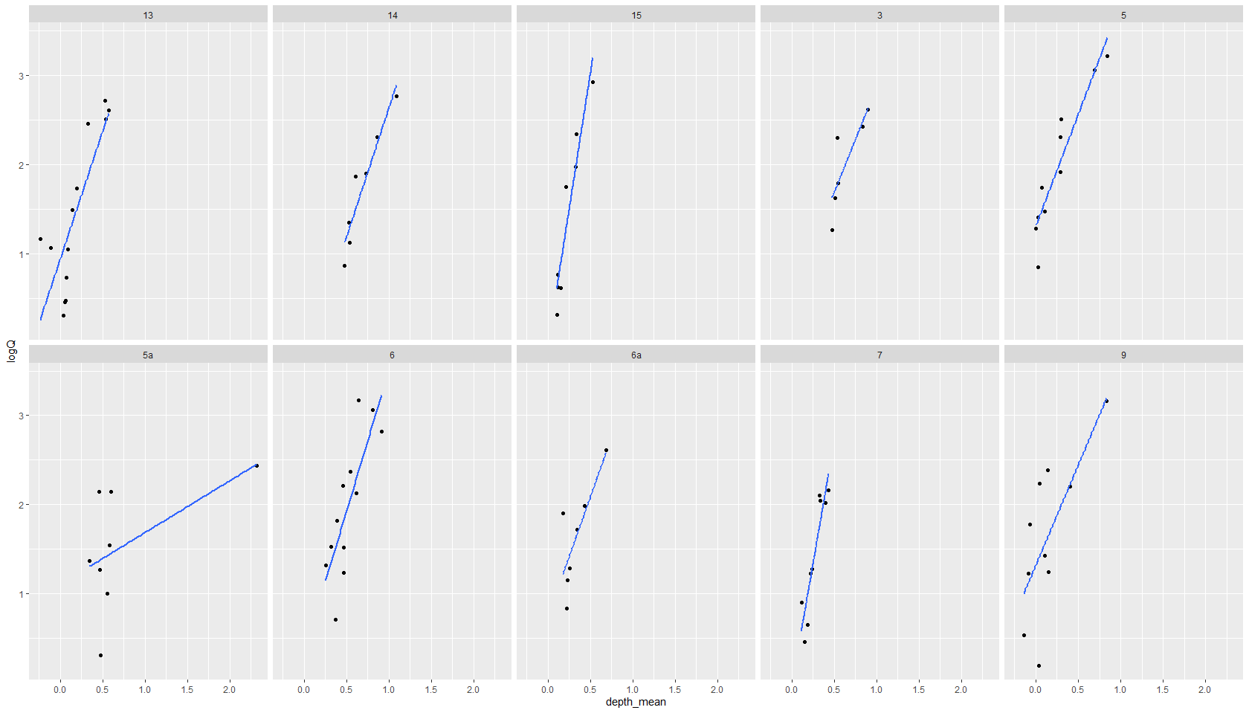

Slide 18
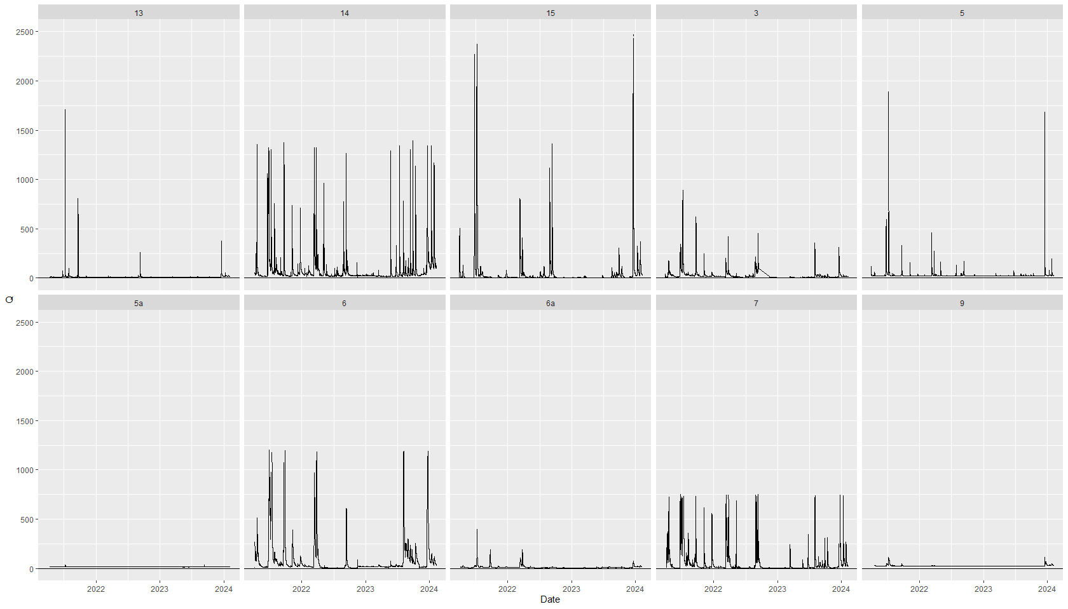

Slide 19

3rd; intermittent
1st
Pine stand/ Uplands
Wells
Wetlands
#
Stream Order
Streams
2nd; Perennial
Capture “Micro-Ecosystems” within the River Corridor

Slide 20
Ecotone (Intermittently wet)
Concentration (mol/L)
Stream bank (Always wet)
Upland (Always dry)
DOC
CO₂
Distance from Stream

Slide 21
Upland (Always dry)
Stream bank (Always wet)
Ecotone (Intermittently wet)
Redox Potential
Distance from Stream

Slide 22
Stream
Upland (Always dry)
Stream bank (Always wet)
Ecotone (Intermittently wet)
Water Table Depth
Distance from Stream

Slide 23
Upland (Always dry)
Stream bank (Always wet)
Ecotone (Intermittently wet)
Rate (???)
Distance from Stream

Slide 24
Surplus
Stream DOC (mg/L) – Wetland DOC (mg/L)
Deficit
Periods of connectivity (days)

Slide 25
Surplus
Stream DOC (mg/L) – Known DOC Inputs(mg/L)
Deficit
Periods of connectivity

Slide 26
High Temp
c
Reactor > Chimney
c
High Temp
Low Temp
c
c
Reactor/Chimney
Low Temp
Reactor < Chimney
c
High Q
Low Q

Slide 27
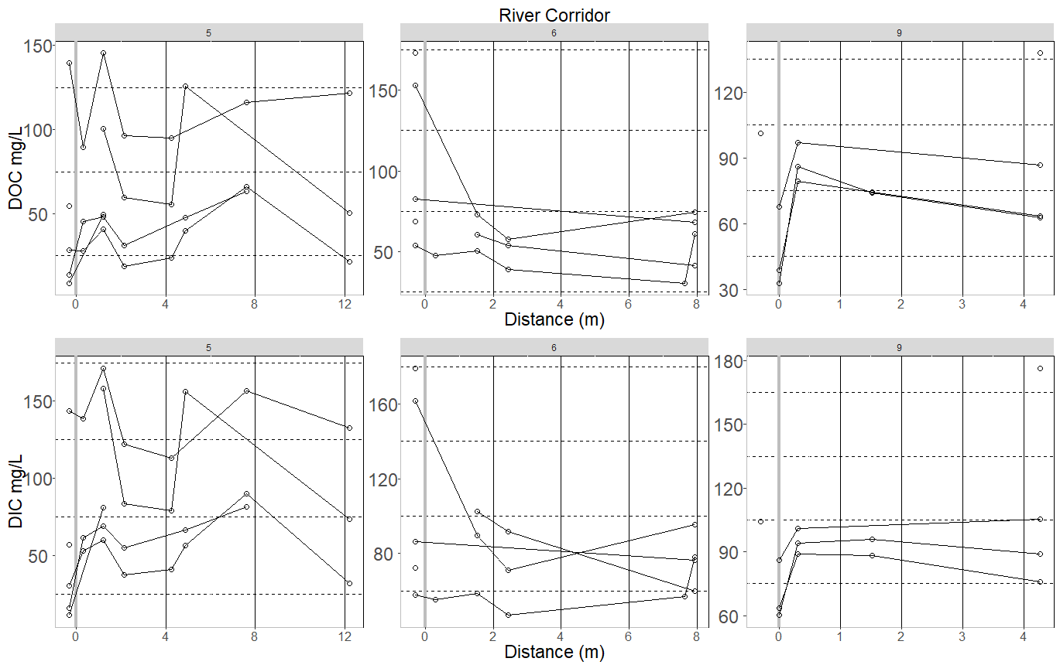

Slide 28
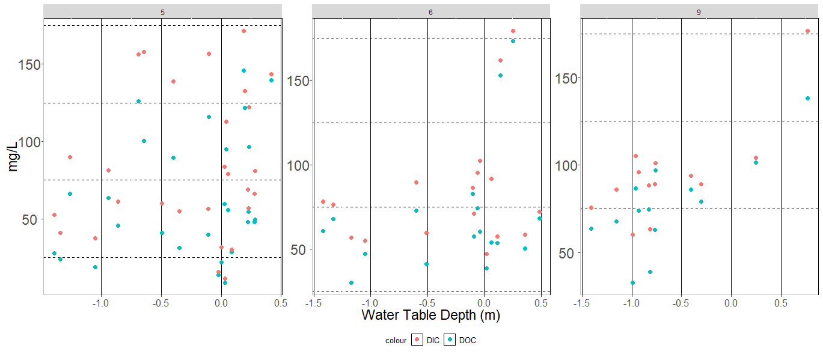

Slide 29
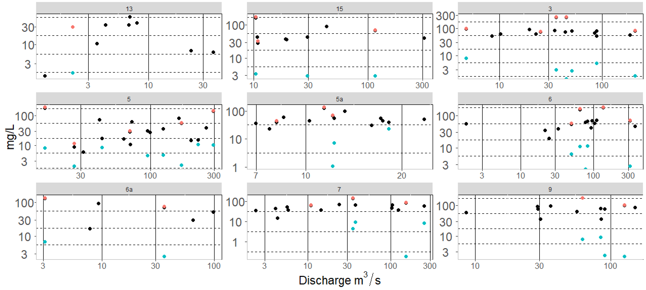


Slide 30
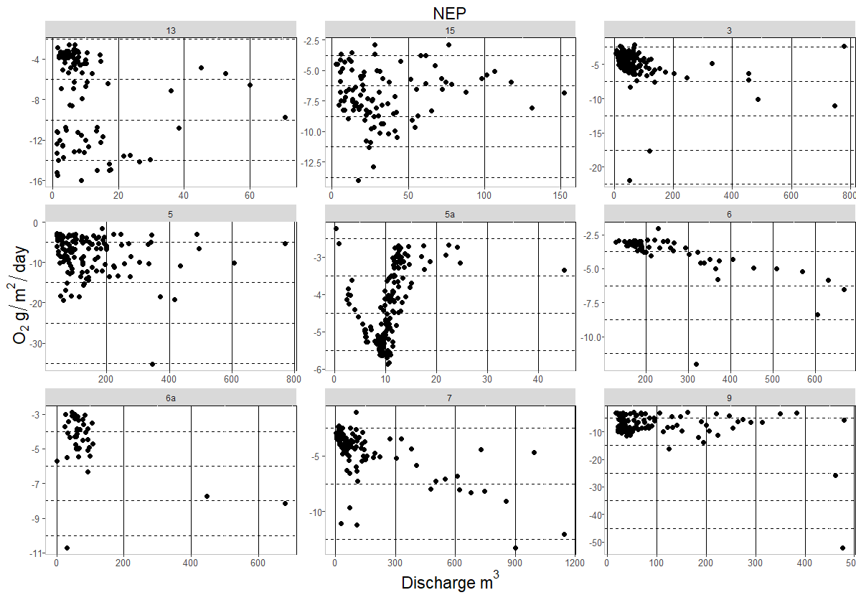

Slide 31
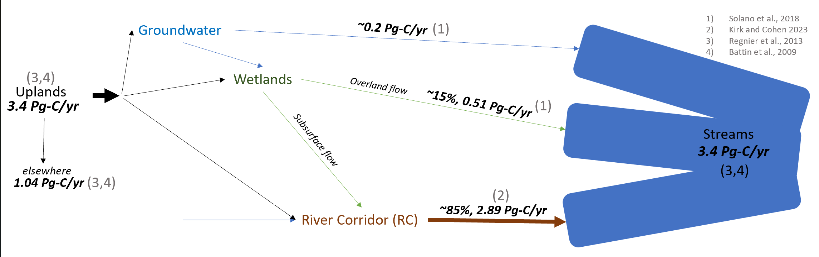
BEF Carbon Budget

